Slide 1
Memory and I/O Interfacing

Slide 2
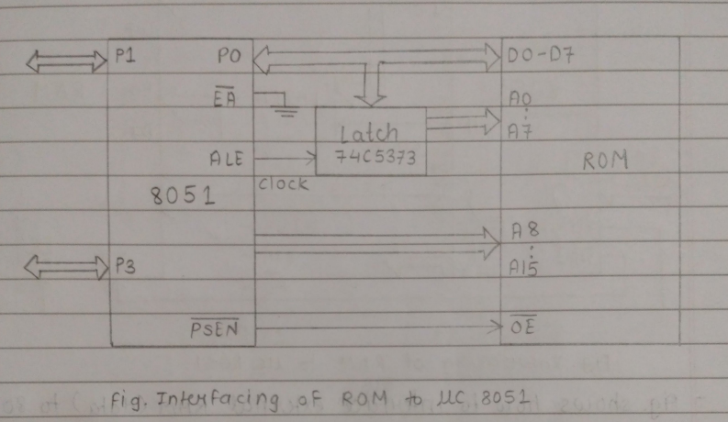
4.1] Memory Interfacing:
Interfacing of external Program memory (ROM):

Slide 3
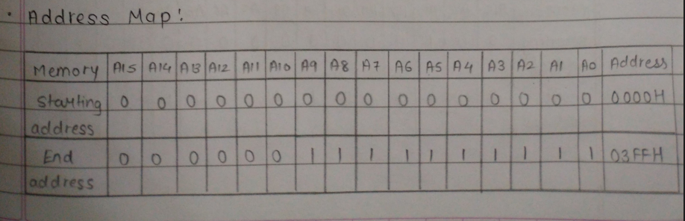
-fig. shows how to access or interface ROM to 8051.
-Port o is Used as multiplexed data and address lines. It give lower order (A7-Ao) 8 bit address f higher order (A8- A15) used as data bus
-8 bit address is latched using external latch & ALE signal From 8051
-PSEN is used to activable the output enable signal of external ROM.
Interfacing of Data Memory- (RAM):.

Slide 4
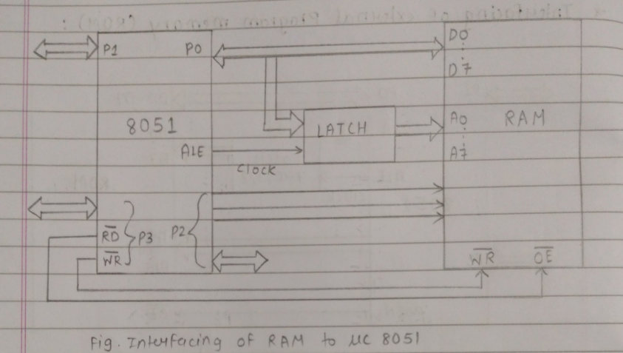

Slide 5
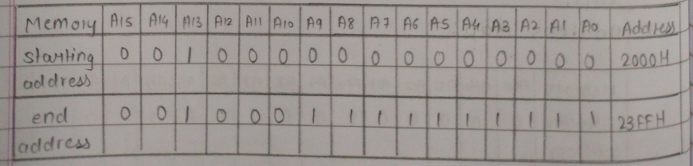
Fig. shows how to interface external RAM (data) to 805).
Port o is used as multiplexed data and address lines
address lines are decoded using external latch f ALE signalArom 8051 to provide lower order (A7-Ao) address lines
Port 2 gives higher order address lines
RD f WR signals From 8051 selects the memory read and memory write operations respectively.
Address Map

Slide 6
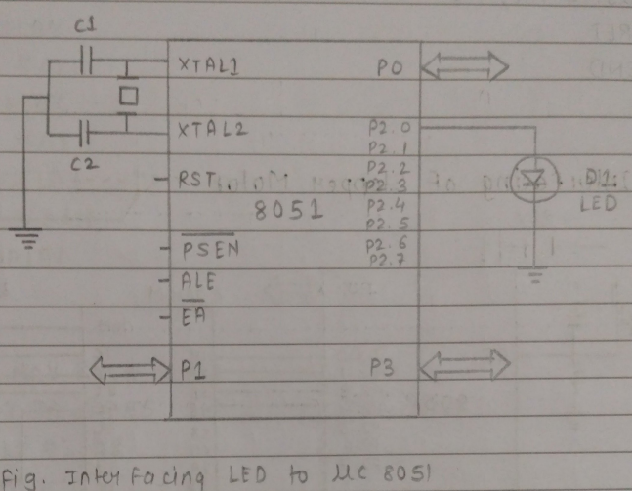
4.2] I/0 Interfacing:-
1) Interfacing of LEDS:-
Fig. shows how to interface the LED to MC 8051
The Anode is connected through a resistor to GND.
And Cathode is connected to the Mc pin.
so when the port Pin is HIGH the LED iS OFF and when it is low the LED is turned On.

Slide 7
ORG 0000H ; Program starts at address 0
UP: SETB P2.0 ; Turn ON LED connected to P2.0
ACALL DELAY
CLR P2.0 ; Turn OFF LED
ACALL DELAY
SJMP UP ; Repeat forever
DELAY: MOV R4, #35
H1: MOV R3, #255
H2: DJNZ R3, H2
DJNZ R4, H1
RET
END

Slide 8
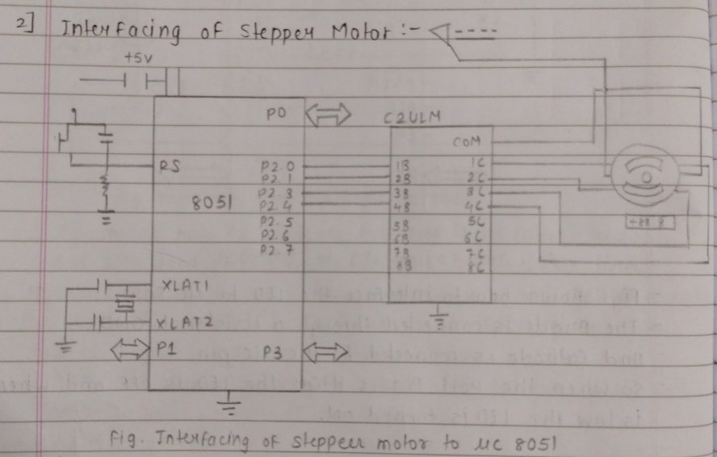
fig. shows how to interface stepper motor to 8051 Mc.
we need to give the o and 1 to the four wires of steeper motor according to the mode we want to run the stepper motor Ware drive mode, full drive mode, Half drive mode
Rest two writes should be connected to a pro per supply.
We have to connect four ends of the coils to the first four pins of port 2 of 8051.

Slide 9
ALP for interfacing stepper motor to 8051 MC:-
ORG 0000H ; Program starts at address 0
UP: MOV P2, #09H ; Step 1 (1001): Energize coils
ACALL DELAY
MOV P2, #0CH ; Step 2 (1100)
ACALL DELAY
MOV P2, #06H ; Step 3 (0110)
ACALL DELAY
MOV P2, #03H ; Step 4 (0011)
ACALL DELAY
SJMP UP ; Repeat steps continuously
DELAY: MOV R4, #18H ; Outer loop for delay
H1: MOV R3, #255 ; Inner loop for delay
H2: DJNZ R3, H2
DJNZ R4, H1
RET
END

Slide 10
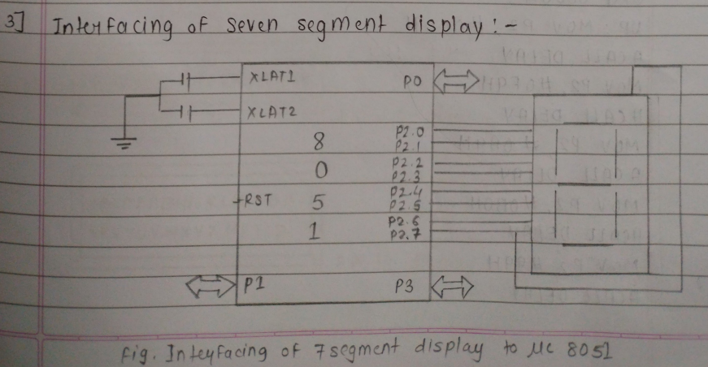
Fig. shows how to interface 7-seg display to 8051 MC.
connect the segments of the display to the output pins of microcontroller.
Then connect the common cathode or anode of the display to a suitable voltage source.

Slide 11
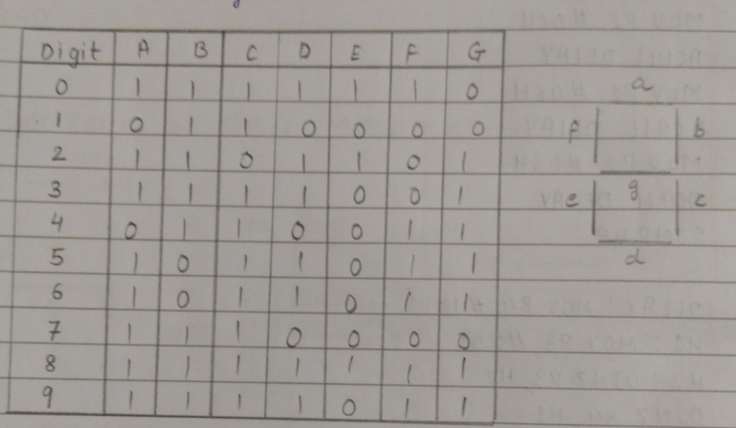
ALP for interfacing seven segment display to 8051 uc:-

Slide 12
ORG 0000H ; Program code starts at 0
UP: MOV P2, #0C0H ; Display 0
ACALL DELAY
MOV P2, #0F9H ; Display 1
ACALL DELAY
MOV P2, #0A4H ; Display 2
ACALL DELAY
MOV P2, #0B0H ; Display 3
ACALL DELAY
MOV P2, #99H ; Display 4
ACALL DELAY
MOV P2, #92H ; Display 5
ACALL DELAY
MOV P2, #82H ; Display 6
ACALL DELAY
MOV P2, #0F8H ; Display 7
ACALL DELAY
MOV P2, #80H ; Display 8
ACALL DELAY
MOV P2, #90H ; Display 9
ACALL DELAY
SJMP UP ; Repeat

Slide 13
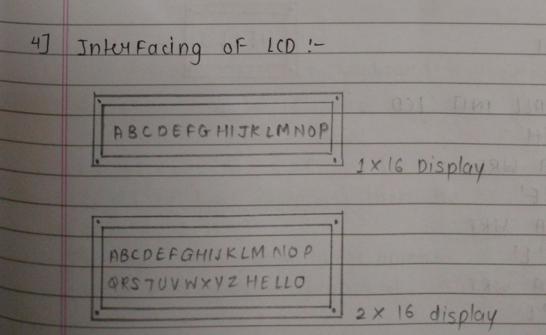
DELAY: MOV R5, #10
H1: MOV R4, #180
H2: MOV R3, #225
H3: DJNZ R3, H3
DJNZ R4, H2
DJNZ R5, H1
RET
END

Slide 14
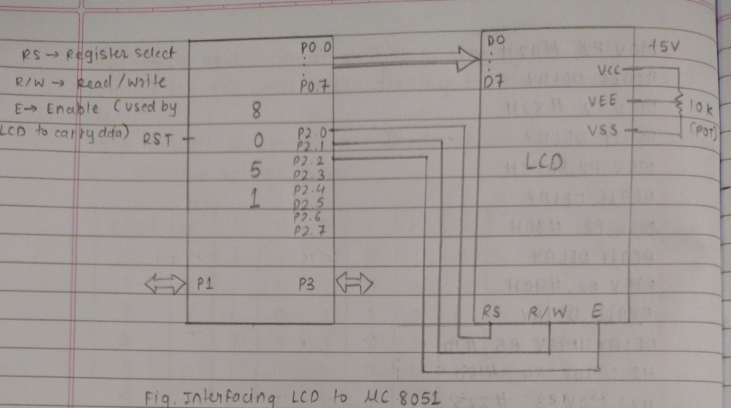
fig. shows how to interface LCD to 8051 uc.
We have connected data pins (DO-D7) OF LCD to port o and control pins (RS, RW, E) to port 2 oF Mс.

Slide 15
ALP for interfacing LCD to 8051 uc to display Hello'
ORG 0000H ; Execution start address
SJMP START ; Skip interrupt vector area
ORG 0030H ; Program starts here
START: ACALL INIT_LCD ; Initialize LCD
MOV A, #'H' ; Load 'H'
ACALL DATA_WRT ; Send to LCD
MOV A, #'E' ; Load 'E'
ACALL DATA_WRT ; Send to LCD
MOV A, #'L' ; Load 'L'
ACALL DATA_WRT ; Send to LCD
MOV A, #'L' ; Load 'L'
ACALL DATA_WRT ; Send to LCD
MOV A, #'O' ; Load 'O'
ACALL DATA_WRT ; Send to LCD

Slide 16
HERE: SJMP HERE ; Infinite loop
;-------------------------
; Subroutine: LCD Initialization
INIT_LCD:
; Your initialization commands here (clear display, function set, etc.)
RET
;-------------------------
; Subroutine: Write Data to LCD
DATA_WRT:
; Your code to send contents of Accumulator (A) to LCD data register
RET
END

Slide 17
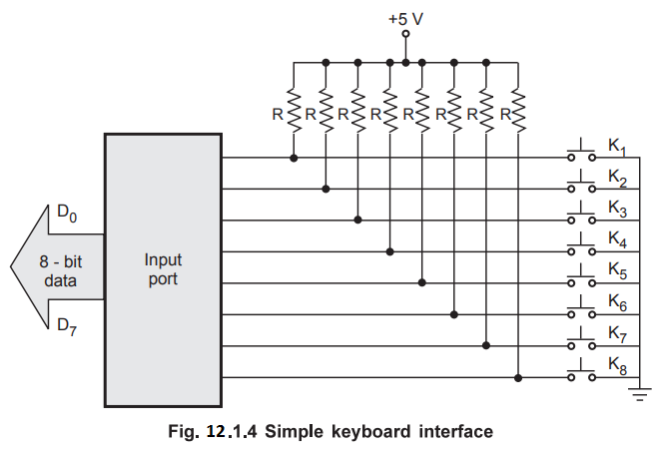
5] Interfacing Keyboard:
1. Non-matrix form:

Slide 18
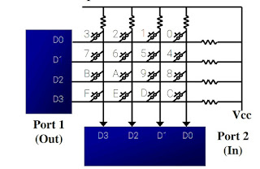
fig. show how to interface keyboard to 8051 Mc in the non-matrix form.
No. of Keys = no. of port lines
IF no. of Keys increases then the no. of port lines also increases.
To avoid this large large number of port lines we can use Matrix type of keyboard.
2. Matrix form:
- 8 Keys = 4x4 matrix
-16 Keys = 8x8 matrix
-32 Keys = 16X16 matrix

Slide 19
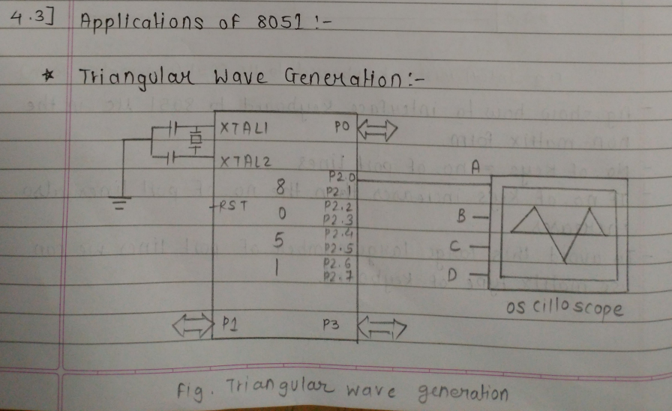
ALP for generating a triangular wave!-

Slide 20
ORG 0000H ; Starting address
CLR A ; Clear accumulator
UP: INC A ; Increment Accumulator
MOV P2, A ; Output to Port 2
CJNE A, #0FFH, UP ; Continue incrementing till 255
LCALL DELAY
DOWN: DEC A ; Decrement Accumulator
MOV P2, A ; Output to Port 2
CJNE A, #00H, DOWN ; Continue decrementing till 0
LCALL DELAY
SJMP UP ; Repeat the wave generation
DELAY:
MOV R4, #18
H1: MOV R3, #255
H2: DJNZ R3, H2
DJNZ R4, H1
RET
END

Slide 21
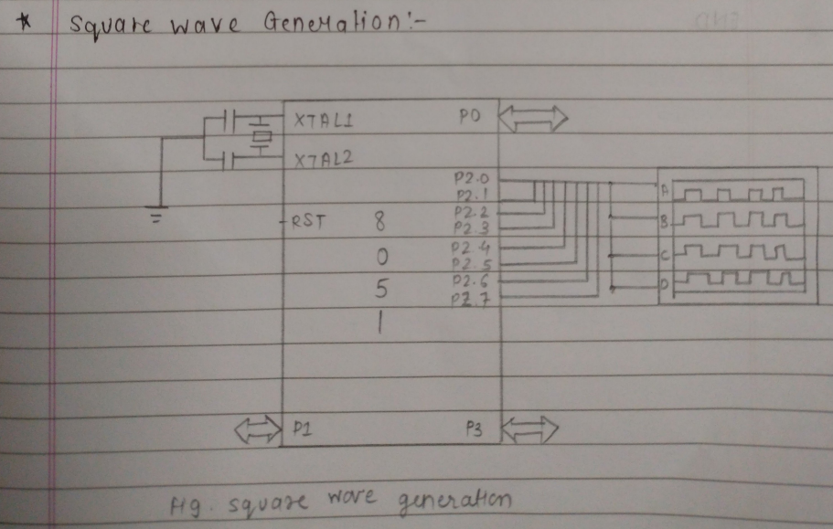

Slide 22
ALP for generating a square wave
ORG 0000H
MOV TMOD, #01H
UP: SETB P2.2
LCALL DELAY
CLR P2.2
LCALL DELAY
SJMP UP
DELAY:
MOV TH0, #FEH
MOV TL0, #0CH
CLR TF0
SETB TR0
HERE: JNB TF0, HERE
RET
END

Slide 23
4.2] Remaining :-
6) Interfacing DC motor:
To interface a DC motor with an 8051 microcontroller, you'll need a motor driver IC like L293D or L298N to handle the motor's high current requirements.
Basic outline:
Motor Driver selection
Wiring
Power supply
Programming
Testing

Slide 24
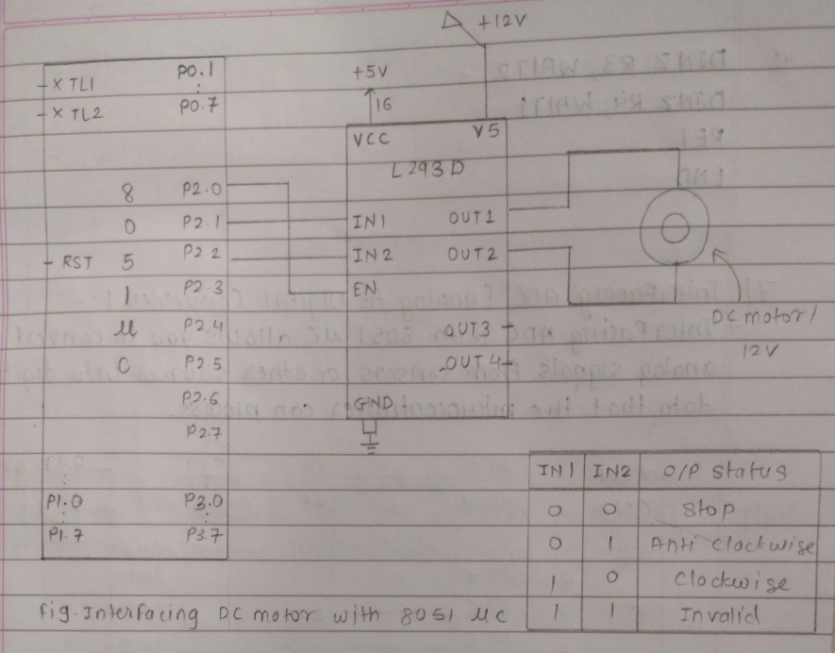

Slide 25
APL For interfacing Dc motor to 8051 MC :-
ORG 0000H ; Start address
SETB P2.0 ; Motor power enable (optional, depends on wiring)
MAIN: SETB P2.1 ; Set direction 1
CLR P2.2
ACALL DELAY
CLR P2.1 ; Set direction 2
SETB P2.2
ACALL DELAY
SJMP MAIN ; Repeat loop
DELAY:
MOV R4, #0FH
WAIT1: MOV R3, #00H
WAIT2: MOV R2, #00H
WAIT3: DJNZ R2, WAIT3
DJNZ R3, WAIT2
DJNZ R4, WAIT1
RET
END

Slide 26
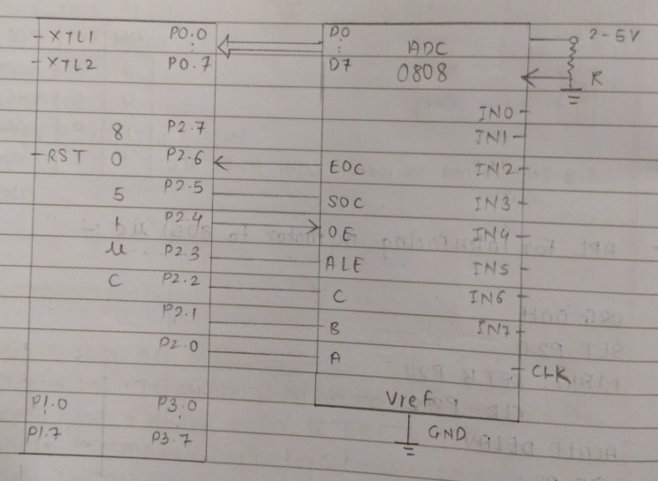
7] Interfacing ADC [Analog to Digital Converter ]:-
Interfacing ADC with 8051 uc allows you to convert analog signals from sensors or other sources into digital data that the microcontroller can process.

Slide 27
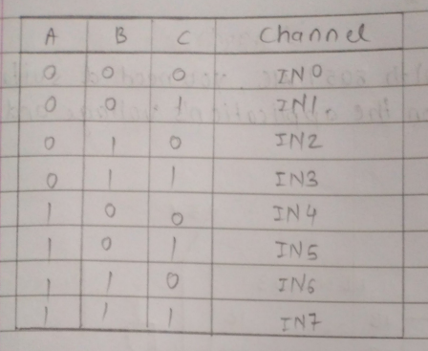
EOC
End of conversion
SOC start of conversion
OF o/p enable
ALE Address Latch enable
Fig Interfacing ADC with 8051 luc

Slide 28
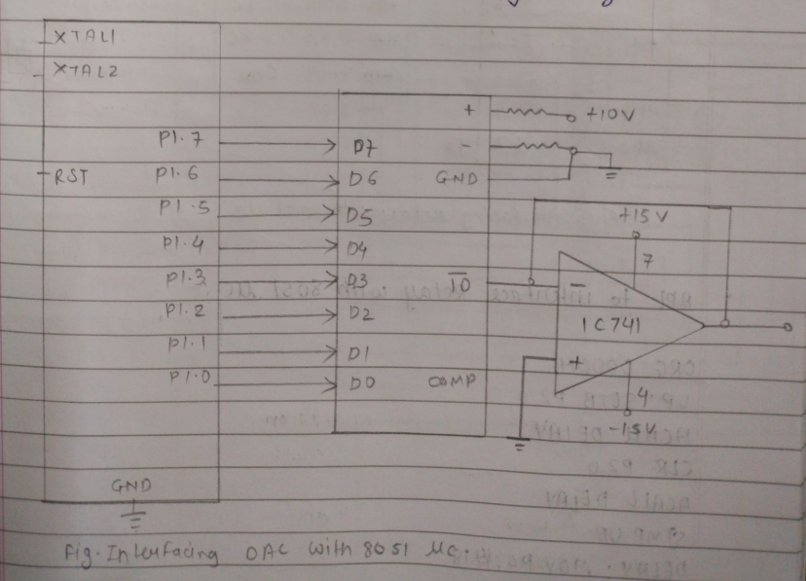
8] Interfacing DAC [Digital to Analog converter]:-
Interfacing DAC with 8051 Mc enables to convert digital signals from microcontroller into analogy voltages.

Slide 29
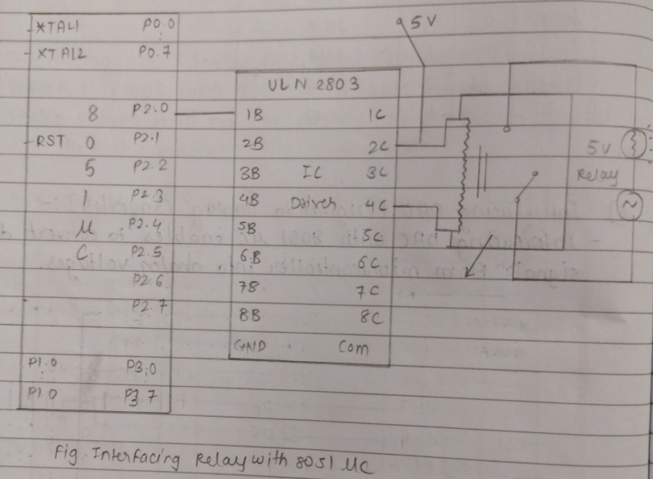
9) Interfacing Relays-
To inter Face relays with 8051 NC, you need a suitable relay module based on the application's voltage and current requirements.

Slide 30
APL to interface relay with 8051 microcontroller :-
ORG 0000H ; Start address
UP: SETB P2.0 ; Turn relay ON (via driver)
ACALL DELAY
CLR P2.0 ; Turn relay OFF
ACALL DELAY
SJMP UP ; Repeat loop
DELAY: MOV R4, #18
HI: MOV R3, #255
H2: DJNZ R3, H2
DJNZ R4, HI
RET
END

Slide 31
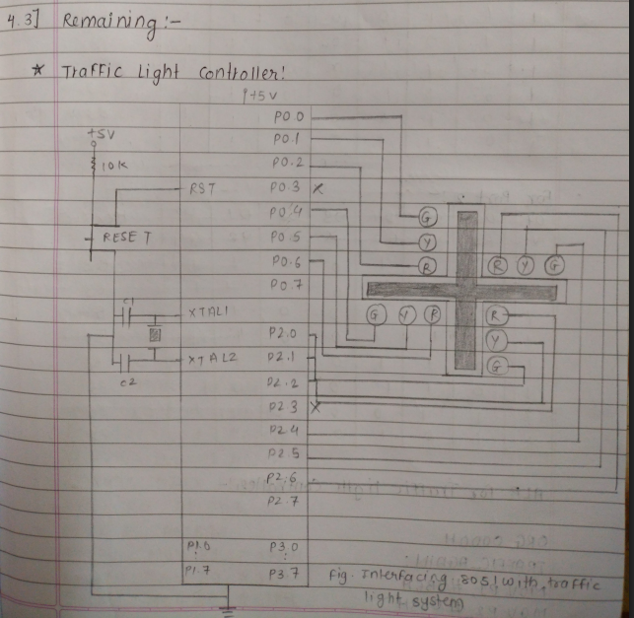

Slide 32
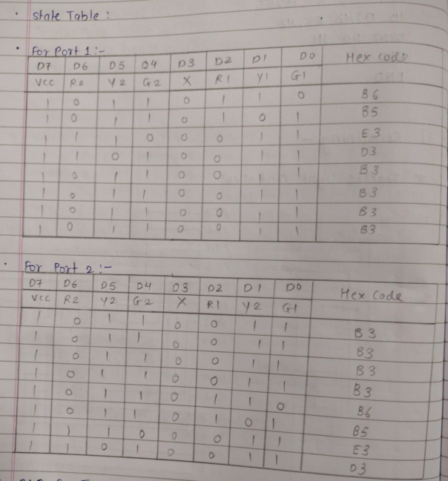

Slide 33
ALP for Traffic light Controller:-
ORG 0000H
TRAFFIC_AGAIN:
MOV P1, #06H ; Port 1 output for green light on
MOV P2, #03H ; Port 2 output
ACALL DELAY
MOV P1, #05H ; Port 1 output for yellow light on
MOV P2, #03H
ACALL DELAY
MOV P1, #E3H ; Port 1 output for red light on
MOV P2, #03H
ACALL DELAY
MOV P1, #D3H
MOV P2, #03H
ACALL DELAY
MOV P1, #03H
MOV P2, #06H
ACALL DELAY

Slide 34
MOV P1, #03H
MOV P2, #05H
ACALL DELAY
MOV P1, #03H
MOV P2, #E3H
ACALL DELAY
MOV P1, #03H
MOV P2, #D3H
ACALL DELAY
SJMP TRAFFIC_AGAIN
DELAY:
MOV R3, #0D5H
DELAY1:
MOV R4, #0FFH
DELAY2:
MOV R5, #0FFH
DELAY3:
DJNZ R5, DELAY3
DJNZ R4, DELAY2
DJNZ R3, DELAY1
RET

Slide 35
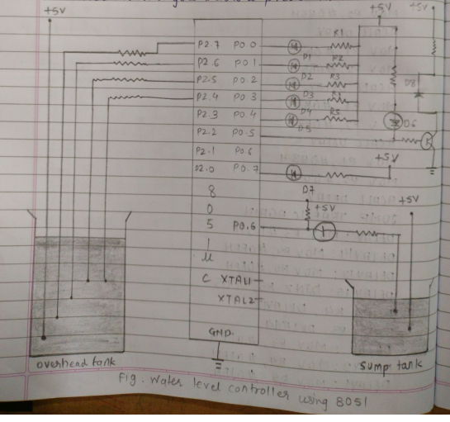
Water Level Controller:-
Water level controller monitors the level of the over head tank and automatically switches on the water pump when ever the level goes below a preset limit:

Slide 36
ALP for Water level controller!-
ORG OOOOH
MOV P2 #IIIIB
MOV P0, #111B
MOV A, #0000 B
MAIN ACALL SMPCK
MOV A, P2
CINE A
SETB PO
SETB PO.2
SETB PO.3
SETB PO 4
SETB PO.5
LABELI MOV A, P2
CINE A, #1100B, LABEL 2
SETB PO.O
SETB PO.2
SETB PO.3
SETB PO.4
LABEL 2 MOV A, P2
CINE A, # II DOB LABEL 3
SETS P0.7

Slide 37
SIMP RET
SETSPO.5
OFF
CLR PO.7
RET
END
Temperature controller using ACD-
To create a temperature controller using ADC in an 805 microcontroller, we need a temperature sensor (LM35, of a thermistor), an ADC module;
1) Interface the temperature sensor
2) ADC Configuration
3) Read Analog input
4) Convent ADC output to temperature
5) Control Logic
6) Feedback loop
7) Output control signal.
* Stepper Motor: Already done

